Slide 1
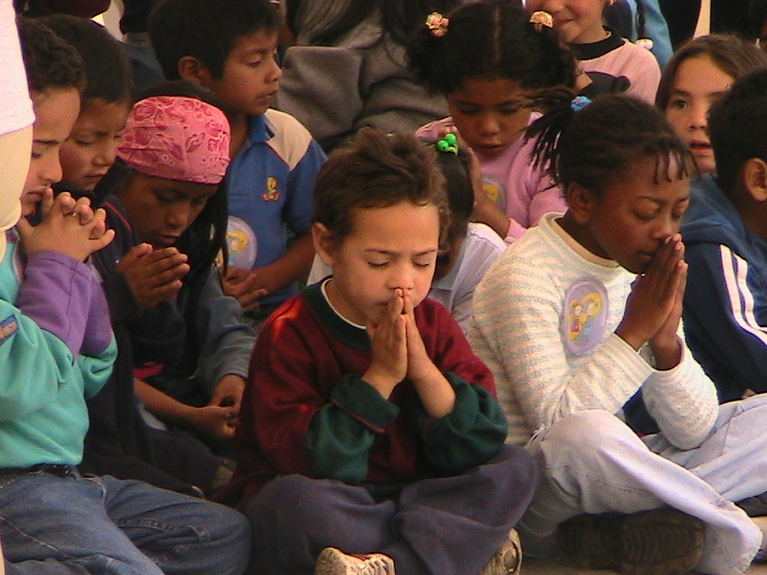
‘Stepping Stones’
for children
to prepare and lead Collective Worship

Slide 2
Basic Principles
The teacher should always prepare and lead most Acts of Collective Worship and be an excellent role model for children to emulate;
Teachers should withdraw their input gradually at the appropriate time - given the age, capacity and stage of development of the children;
It must never detract from being an enriching experience where glory, honour and praise is given to God;
The REJOICE part of Come and See is a good place to start the process of involving children in preparing and leading worship;

Slide 3
Basic Principles continued.
Prepare... Focus / setting / music / ICT / resources etc.
Gather... How? To what? How does it start?
Listen... What SCRIPTURE is used? How is it shared?
Respond... How? include – PRAYER and SILENT reflection
Go Forth... How? What? Why?
Evaluation... How did it go? How could it improve?
The required elements of Collective Worship should always be present to assist with the children’s liturgical formation;
The recommended planning format should be used for all age groups. (Some may just prepare / lead in one or two elements);
Timings should always be appropriate for the age of the children.

Slide 4
Early Years and Years 1-2
Teacher models and leads;
At this age, children are facilitating Worship, rather than leading it. They may lead certain elements / parts;
Reverence for the Word of God in Scripture should be shown and expected from the earliest years.

Slide 5
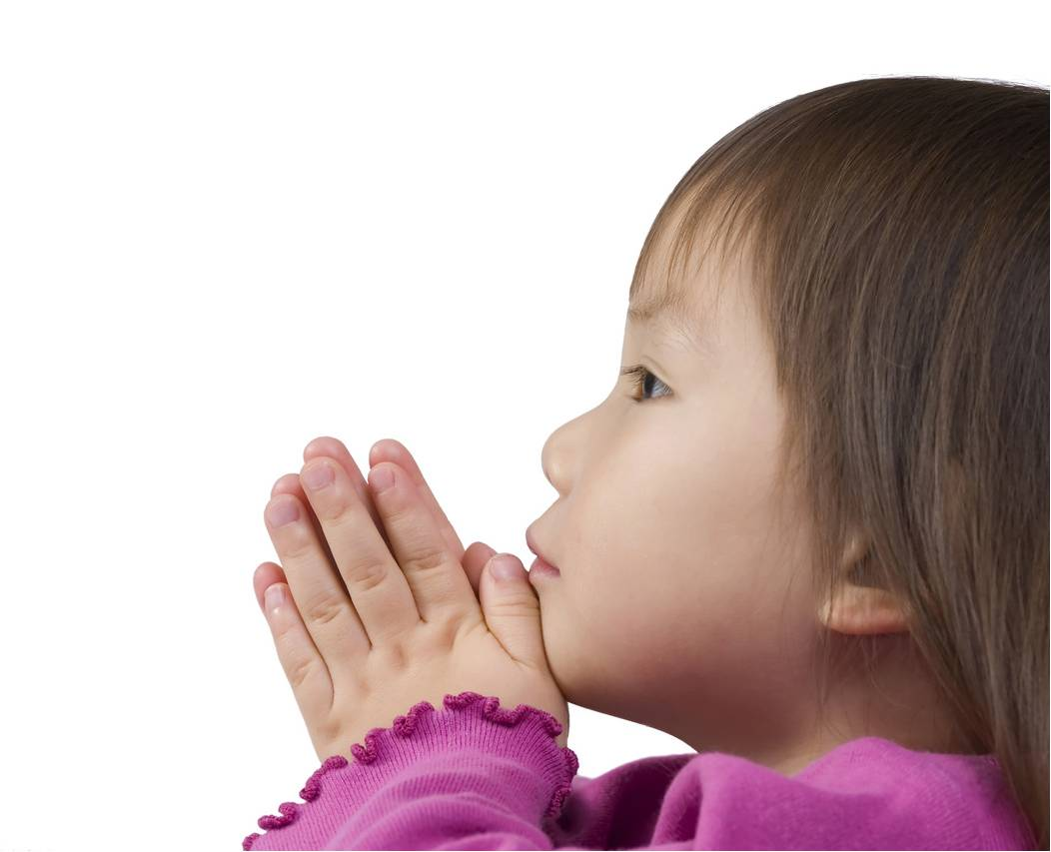
Nursery and Reception
Children may...
Sing a gather Song;
Make the Sign of Cross;
Choose suitable artefacts – given a very limited choice;
Greet everyone;
Set up focus table;
Pass things round;
Say prayers;
Say who/what they want to pray for.

Slide 6
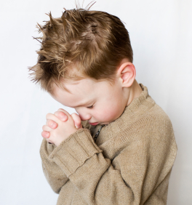
Year 1
Nursery / Reception plus...
Choose suitable artefacts from a less limited selection;
Given the theme, choose an appropriate way to Gather / Go forth (– from a limited selection – C.D.);
Teacher-input to help

Slide 7
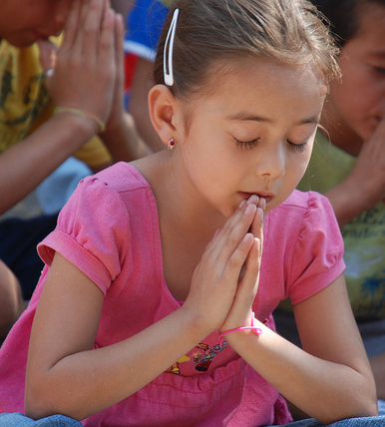
Year 2
All Y1 plus...
Can explain the purpose, theme and focus;
Using the CD resources, can choose a suitable..
Gather
Listen
Respond and
Go Forth.

Slide 8
Years 3-6
Teachers should be excellent role models in preparing and delivering Collective Worship;
Teachers and pupils work together at first to prepare Collective Worship. Teachers withdraw support gradually. Pupils take over;
Teachers direct what happens and withdraw direction gradually. Pupils take over;
Teachers should provide themes and Scripture and oversee the children’s efforts before delivery. Teachers can withdraw this provision if appropriate.

Slide 9
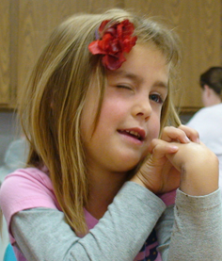
Years 3 - 4
All Year 2 plus....
Children may...
provide a suitable focus without limit of choice. They understand their choice and can make appropriate use of liturgical colours;
lead singing;
work I.C.T. equipment etc.;
write prayers and petitions etc. for inclusion that fit the theme of the Collective Worship;
make full use of the C.D. to choose suitable ways to Gather, Listen, Respond, Go Forth etc.

Slide 10
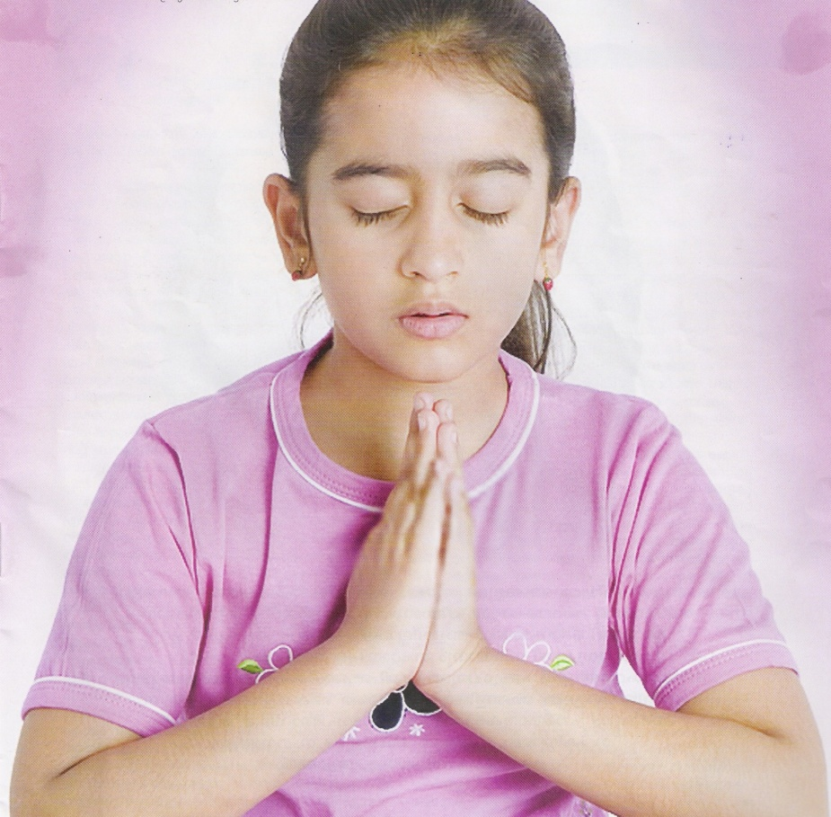
Years 5 - 6
All Y3 – 4 plus...
Given the set theme, pupils can now select appropriate Scripture passages (initially from a limited selection);
By end of Y6, all elements should be in place. Pupils should be able to develop all parts of Collective Worship independently with understanding when given a theme or a passage from Scripture.

Slide 11
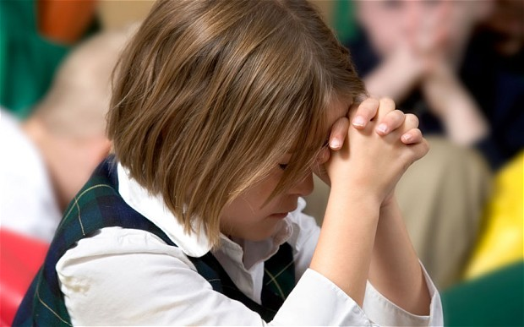
Children Leading....
Some will be more able / willing than others. There should be no coercion, but all children should have the opportunity to prepare / lead Collective Worship if they wish to do so at the teacher’s discretion.

Slide 12
Evaluations
All Collective Acts of Worship should be evaluated by the teacher.
The children should evaluated their own
Others should sometimes asked to evaluate in an appropriate manner.
- What did you enjoy?
- What would you have done?

